Slide 1
B-Trees
Properties and Operations

Slide 2
B-Trees
B-Tree is a self-balancing search tree. In most of the other self-balancing search trees (like AVL ) it is assumed that everything is in main memory.

Slide 3
Concept behind B-Tree
To understand the use of B-Trees, we must think of the huge amount of data that cannot fit in main memory. When the number of keys is high, the data is read from disk in the form of blocks. Disk access time is very high compared to the main memory access time. The main idea of using B-Trees is to reduce the number of disk accesses.

Slide 4
B-Trees : Concept
Most of the tree operations (search, insert, delete, max, min, etc ) require O(h) disk accesses where h is the height of the tree.
B-tree is a fat tree. The height of B-Trees is kept low by putting maximum possible keys in a B-Tree node.
Since the height of the B-tree is low so total disk accesses for most of the operations are reduced significantly compared to balanced Binary Search Trees like AVL Tree, Red-Black Tree, etc

Slide 5
Properties of B-Tree
For balancing the tree each node should contain n/2 keys. So the B tree of order n can be defined as:
All leaf nodes should be at same level.
All leaf nodes can contain maximum n-1 keys.
The root has at least two children.
The maximum number of children should be n and each node can contain k keys. Where, k<=n-1.
Each node has at least n/2 and maximum n nonempty children.
Keys in the non-leaf node will divide the left and right sub-tree where the value of left subtree keys will be less and value of right subtree keys will be more than that particular key.

Slide 6


Slide 7
B-Tree Properties (Balanced Tree)
👉 All leaf nodes are at the same level. No leaf is deeper than another.
👉 Each node can store more than one key, not just one like in binary trees.
👉 Keys in every node are stored in sorted order for fast searching.
👉 Each key in a node splits the range for its child nodes: Left child < key
Right child > key

Slide 8
👉 Each node (except root) must have: At least ⌈m/2⌉ children (if order is m) At most m children
Efficient Searching 👉 You search in a node like in an array, then move to a child if needed.
Used in Disk Storage 👉 B-trees are good for large data stored on disks like databases and file systems.

Slide 9
B-tree of Order 5 (m = 5)
Max Children per node = m = 5
Max Keys per node = m - 1 = 4
Min Children per node = ⌈m/2⌉ = ⌈5/2⌉ = 3
Min Keys per node = Min Children - 1 = 3 - 1 = 2

Slide 10
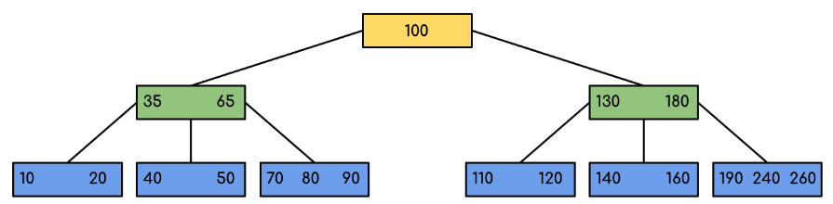
Example

Slide 11
Example: Searching 120 in the given B-Tree

Slide 12
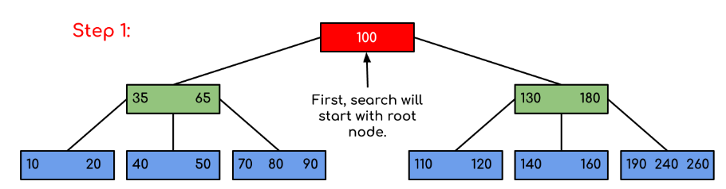
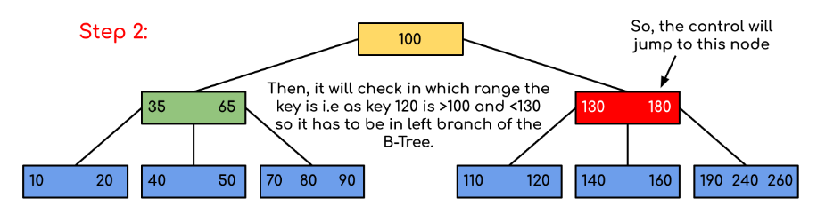
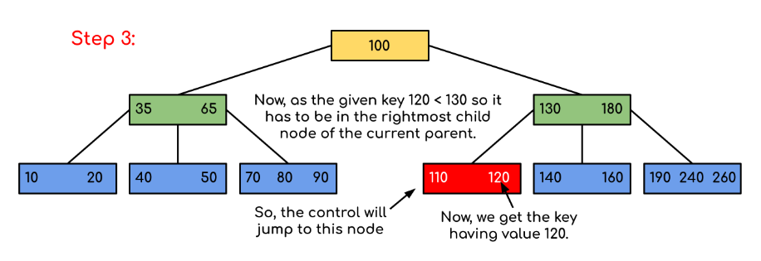
Solution:

Slide 13
B-Tree performance
Let h = height of the B-tree.
get(k): at most h disk accesses. O(h)
put(k): at most 3h + 1 disk accesses. O(h)
remove(k): at most 3h disk accesses. O(h)
h < log _{d} (n + 1)/2 + 1 where d = ⎡m/2⎤ (Sahni, p.641).
An important point is that the constant factors are relatively low.
m should be chosen so as to match the maximum node size to the block size on the disk.
Example: m = 128, d = 64, n ≈ 64³ = 262144 , h = 4.

Slide 14
2-3 Trees Properties and Operations
A B-tree of order m is a kind of m-way search tree.
A B-Tree of order 3 is called a 2-3 Tree.
In a 2-3 tree, each internal node has either 2 or 3 children.

Slide 15
Insertion in 2–3 Trees Key Idea: Maintain balance by splitting nodes Steps: Insert key into appropriate leaf node If node has space (1 key → becomes 2 keys), insert directly If node is full (already 2 keys): Split node into two nodes Promote middle key to parent If parent is full → repeat split upward If root splits → new root is created Result: Tree remains balanced with all leaves at same level

Slide 16
Deletion in 2–3 Trees Key Idea: Maintain minimum keys using redistribution or merging Steps: Delete key from leaf node If node still has ≥1 key → done If node becomes empty: Borrow (redistribute) from sibling if possible Otherwise merge with sibling and pull key from parent If parent underflows → repeat upward If root becomes empty → reduce tree height Result: Tree stays balanced and ordered

